Slide 1
Youtube data harvesting and warehousing

Slide 2
Introduction
Youtube data harvesting and warehousing
using Python scripting , Postgres, streamlit
code integrates Streamlit with PostgreSQL and the YouTube Data API to create a web application for harvesting, storing, and querying YouTube data.

Slide 3
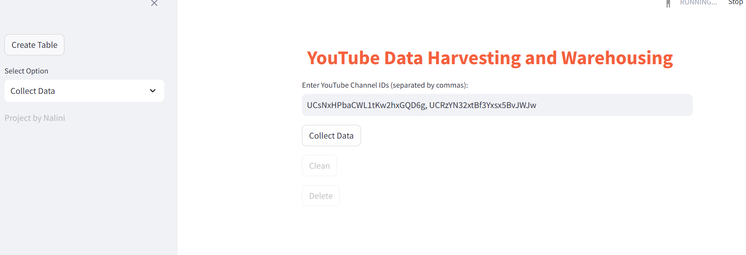
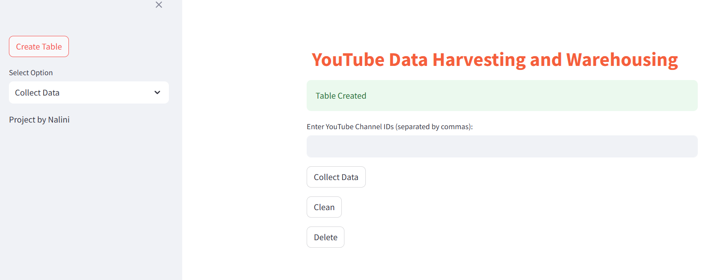
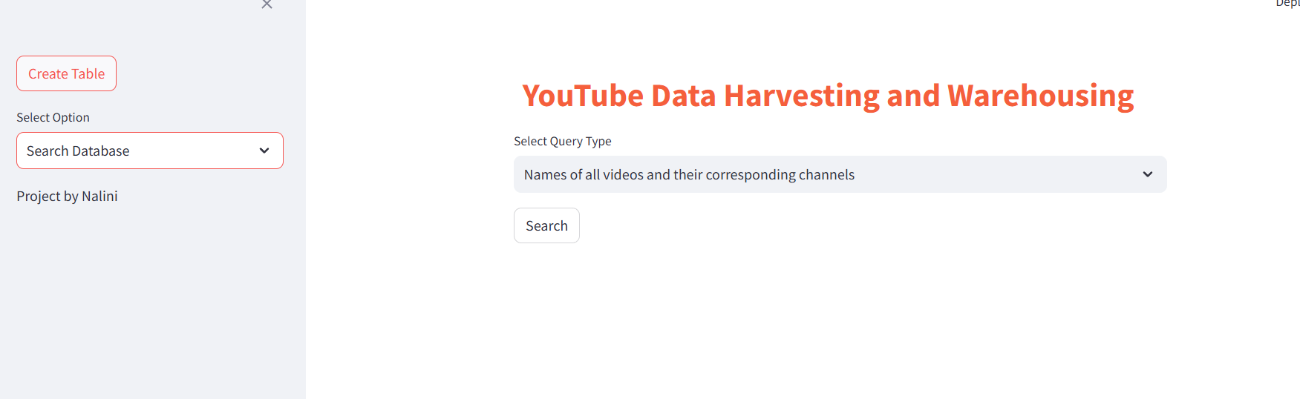
App Interface
The app interface will open in your default web browser. You'll see a title "YouTube Data Harvesting and Warehousing" along with options in the sidebar. The "Create Table" button for creating table. Use it if you're running the app for the first time. Choose between "Collect Data" and "Search Database" options from the sidebar.

Slide 4
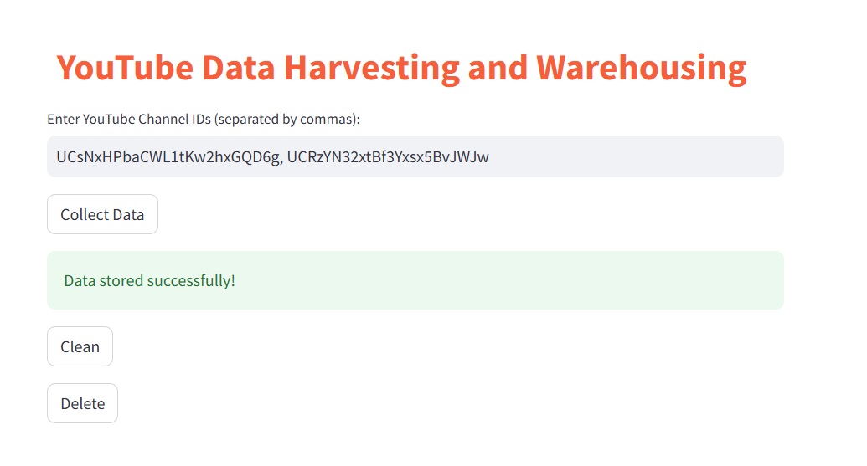
If you select "Collect Data": Enter YouTube channel IDs separated by commas in the text input field. Click the "Collect Data" button to fetch data for the provided channel IDs from the YouTube Data API. The data will be stored in your PostgreSQL database.

Slide 5
If you select "Search Database": Choose a query type from the dropdown menu. Click the "Search" button to execute the selected query on the database. Results will be displayed in a table below.

Slide 6
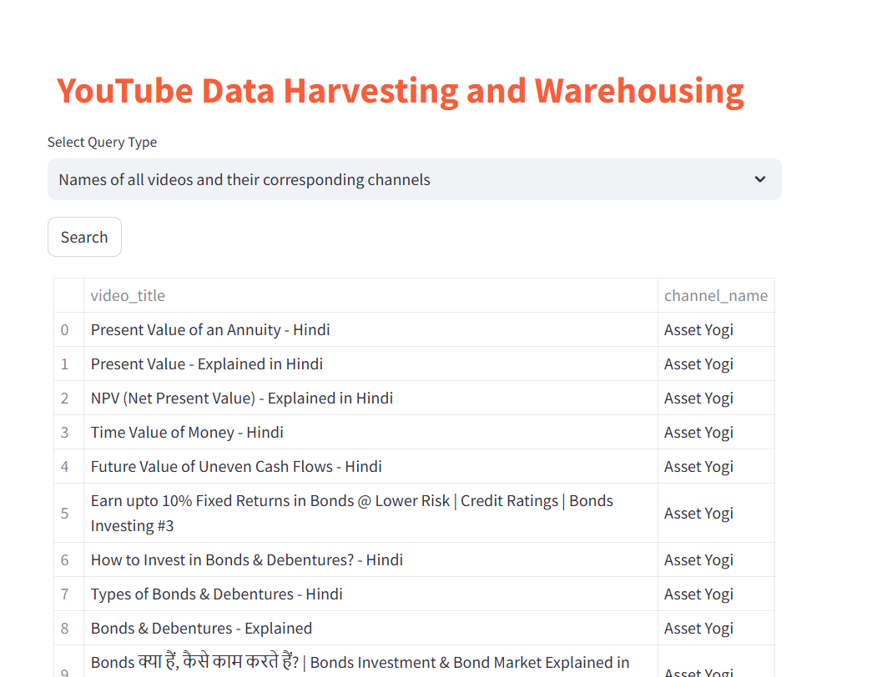
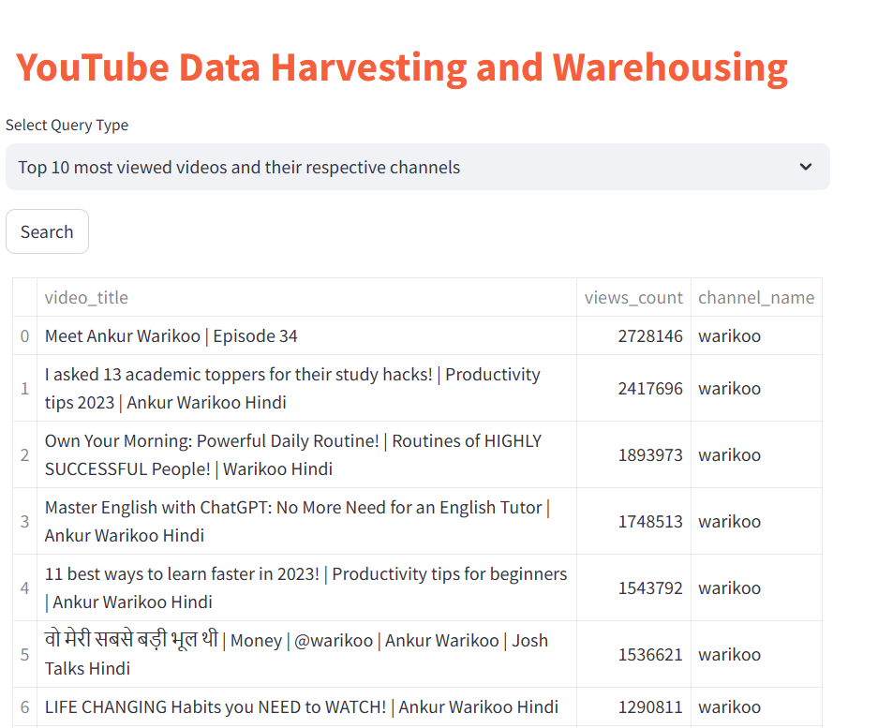
The app displays data fetched from the YouTube API and stored in the PostgreSQL database. Search query results are displayed in tabular format, making it easy to interpret and analyze the data.

Slide 7
END
Thank You

